Slide 1
Neuron Spiking
Analysis in SPSS
Victoria Heimer-McGinn
2025
This exercise assumes a basic level of familiarity with statistical analyses like ttests and multivariate analysis of variance (MANOVA). Familiarity with SPSS is not required but will certainly help. You can use SPSS directly from the Rcloud at RWU.

Slide 2
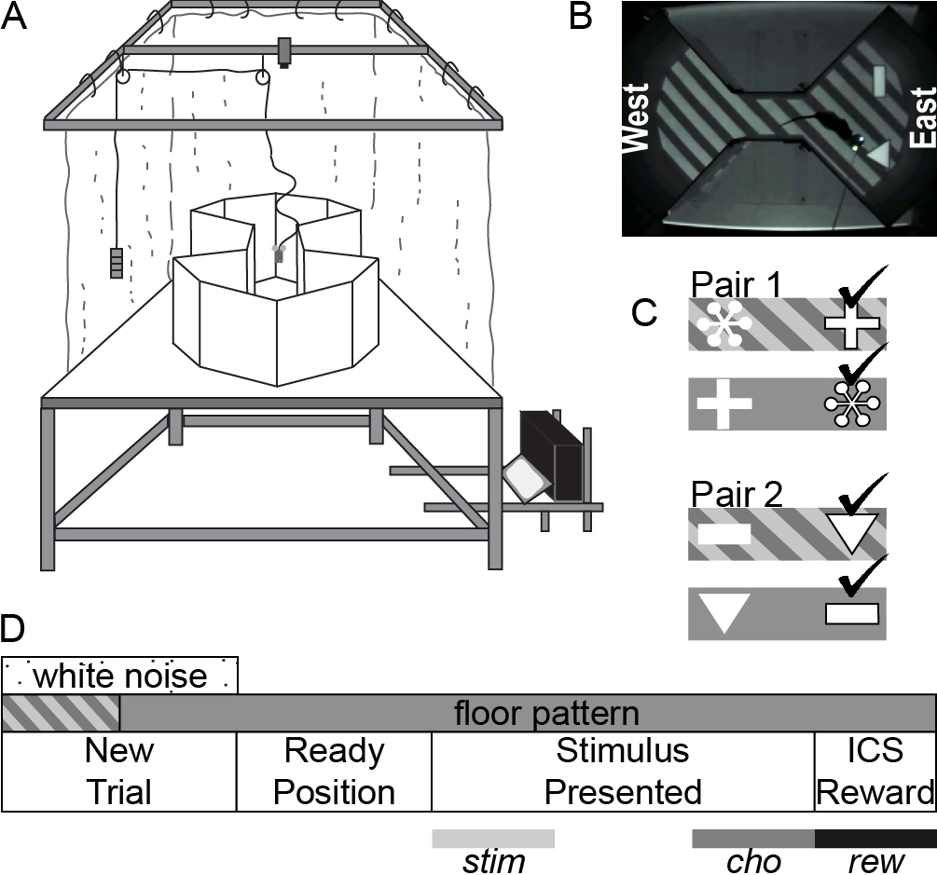
Experimental Setup
Overall goal: to determine whether neurons in a part of the brain called the POR help us process our visual surroundings.
Method: A sensor was surgically implanted in a rat’s POR, which allowed us to measure the electrical activity of individual neurons while the rat was performing a visual task. The arena had a translucent floor, on which we could project images using automated software (Fig 1A-B).
Behavioral Task: The rat had to approach the ‘correct’ object in order to receive a reward. The object that was rewarded (e.g., line vs triangle) depended on the floor, which could be either gray or striped (Fig 1C).
Behavioral Learning: The rat learned through trial and error, performing 1 daily session of 100 trials for 14 days. At the beginning of each trial (Fig 1D), the floor changed at random, sometimes staying the same, other times changing from either grey→stripe OR stripe→grey.

Slide 3
Experimental Setup
Neuronal Measures: Each time the floor changed, we measured how individual neurons reacted. Specifically, we measure how many ‘spikes’ each neuron produces in the 500 milliseconds before and after the floor changes.
Hypothesis: POR neurons will react to the floor change by increasing or decreasing their firing rate (# of spikes/sec).
Significance: This would demonstrate that POR neurons monitor our visual surroundings. This is the first step in a complex process leading to the rat’s ability to make contextually-guided choices (triangle is correct in a striped room but incorrect in a grey room).
Relevance to humans: The POR (or PHC as it’s called in humans) likely guides your behavioral choices to act differently in a library compared to a park or a bar. Specifically, the neurons in this area are monitoring the visual surroundings and allowing you to ‘detect’ that it’s a library or a park in the first place.

Slide 4
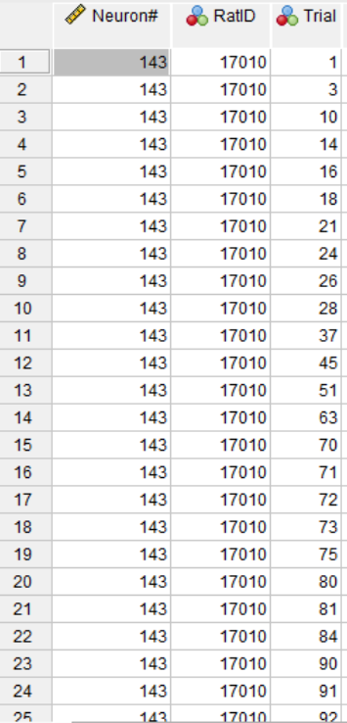
Dataset
Open the data file and inspect it to make sure you understand what is in each row and column
The dataset includes data from 4 POR neurons.
Each row represents a trial, so, for each neuron, there will be as many rows as there were trials.
In the overall task, there were 100 trials. However, since the floor didn’t change at every single trial, you’ll notice that some trials are missing from this data. They were removed to simplify your analysis
Also, since each neuron was recorded on a different day (with the floor changing randomly in different trials), you’ll see that the trial numbers will vary between neurons.
There is also information about each trial that includes which floor was activated, which object pair was displayed, which side of the maze, etc. These are not necessary for this analysis.
If you go to “Variable View” (tab at the bottom) you can see a legend that explains what the numbers in those columns mean.

Slide 5
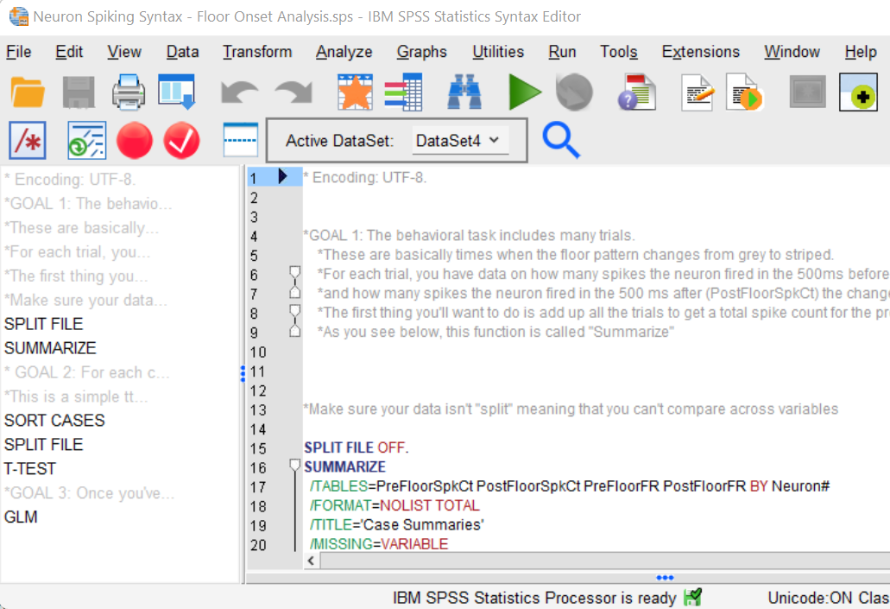
Running the Analyses
Open the syntax file
This file includes information about the types of analyses that you can run with this data.
Inspect the instructions (words in grey) and make sure you understand the basic concept of the statistics first.
Then inspect the code (blue)
Run the code
In the dropdown menu called “Active DataSet”, make sure the correct file is displayed.
Then, you can select portions of the code and press Run (the green triangle)

Slide 6
Notes
If you’ve used SPSS before, you’ll know that these analyses are easily run without a code or syntax file.
However, with large datasets, you often need to run the same tests many times, so being able to just press a “Play” button makes it easier.
For example, the dataset provided to you is a small fraction of the total data. The full dataset took 2 years to collect, with several rats implanted, all of whom performed the task for a minimum of 12 daily sessions. We often ran the analysis after every couple of sessions to assess how many new neurons we had captured.
The complete raw dataset, before “cleaning it up” (i.e., applying exclusion criteria) included 532 neurons.
The published article on this data can be found here: https://www.biorxiv.org/content/10.1101/2022.06.23.497405v2
Refer to Figure 3A-B for examples of how you would graph the data using a histogram. You’ll see that time is on the x axis, with “0” indicating the moment at which the floor changed. On the y axis, you’ll see the firing rate (or spikes per second). Neurons 167 (Fig3A) and 155 (Fig3B) are included in your dataset.

